Slide 1
Exploring the Impact of Weights on Log-Relative Risk Surfaces
GISC6387: Master’s Project
By
Junming Yue
Advisor: Dr. Michael Tiefelsdorf
December 8th, 2017

Slide 2
Motivation
Log-relative risk kernel densities is a point pattern method that is frequently used to investigate the spatial distribution of cases relative to their underlying controls.
Usually, each case and control location is based on a single incidence rather than on aggregated values.
If cases and controls are aggregates, each point must be weighted by its underlying aggregate size.
Motivational example: Priyanka Vyas’s Ph.D. research (2017):
See evaluated spatial mismatch between primary health care facilities (cases) and the health care demand (controls) in Bangladesh.
No reliable estimates for the demand (population in an small area) were available, therefore the distribution of elementary schools was used as proxy to measure the demand.

Slide 3
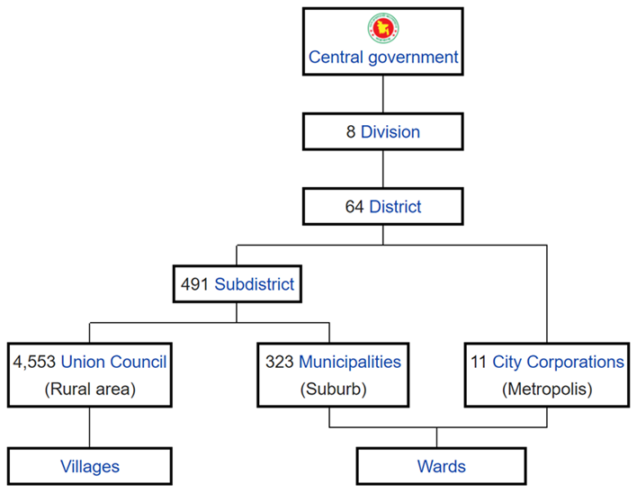
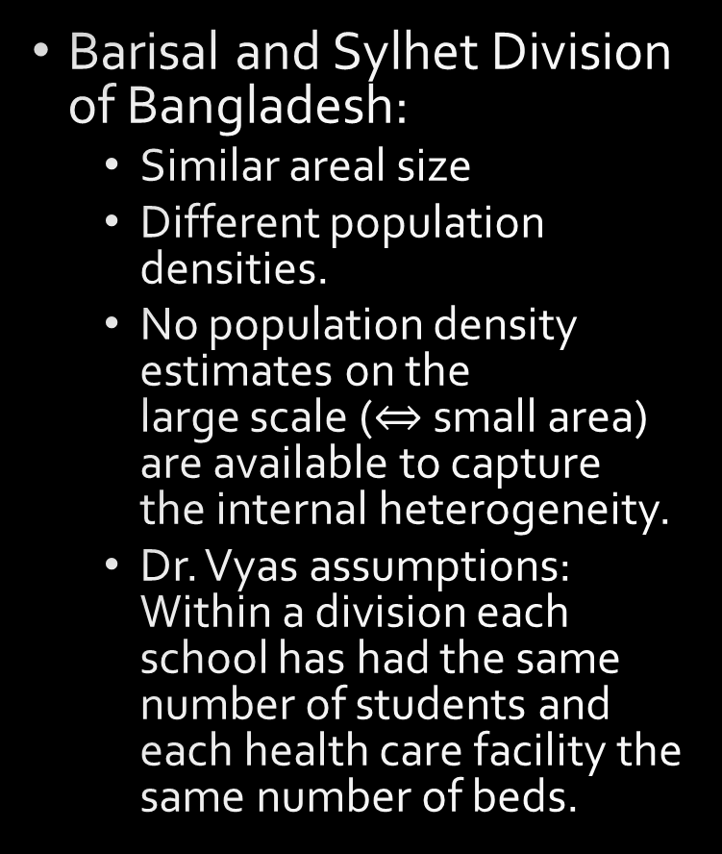
Dr. Vyas’s Study Area
Barisal and Sylhet Division of Bangladesh:
Similar areal size
Different population densities.
No population density estimates on the large scale ($⇔$ small area) are available to capture the internal heterogeneity.
Dr. Vyas assumptions: Within a division each school has had the same number of students and each health care facility the same number of beds.

Slide 4
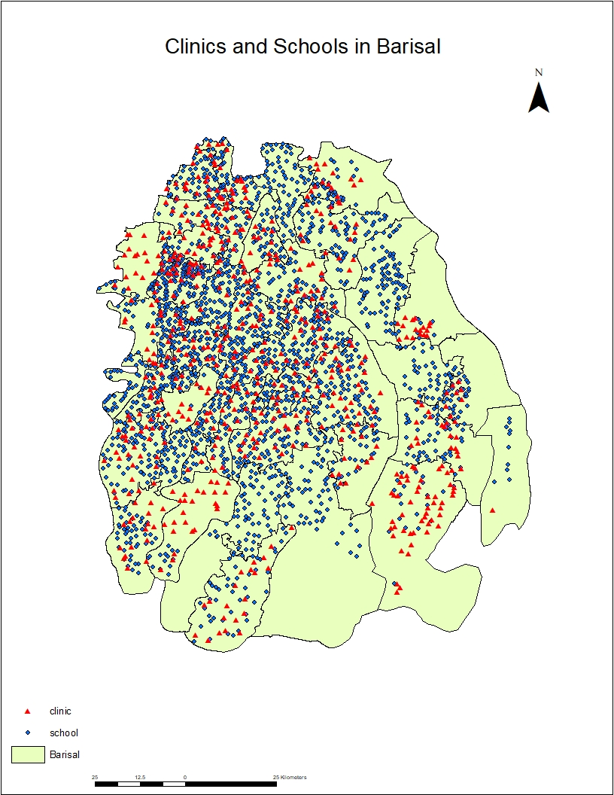
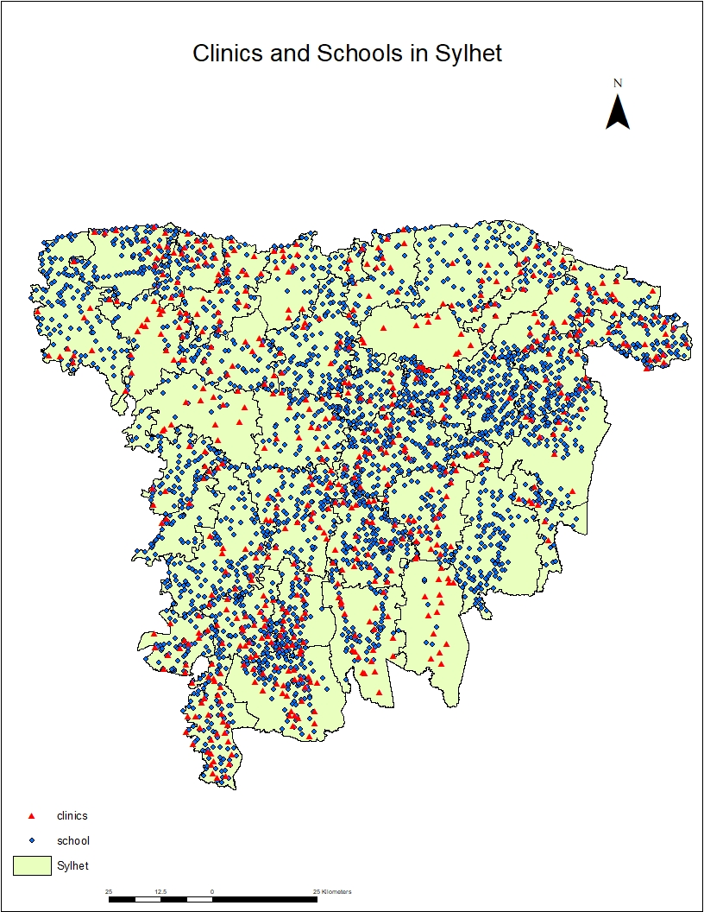
Motivational Example
Cases: Locations Clinics (red)
Controls: Location of Schools in (blue)
Overall the distribution of cases seems to follow that of the controls

Slide 5
Research Questions:
Do the results change if the underlying size of the cases and controls varies.
For example: Schools and clinics sizes vary in urban and rural areas?
Different scenarios:
Common weights of clinics and schools at a given location
Differential weights for clinics and schools at a given location
Initial Conjecture:
As long as the weights in sub-areas are constant for both cases and controls, spatial heterogeneity is irrelevant because common case and control weight in the numerator and denominator cancels each other out.

Slide 6
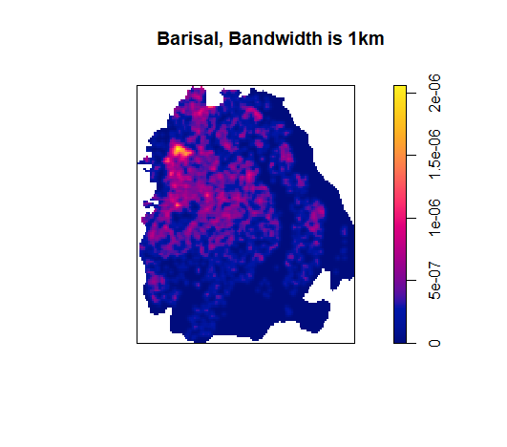
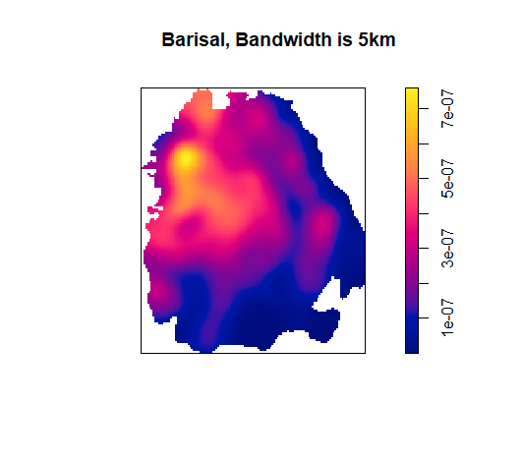
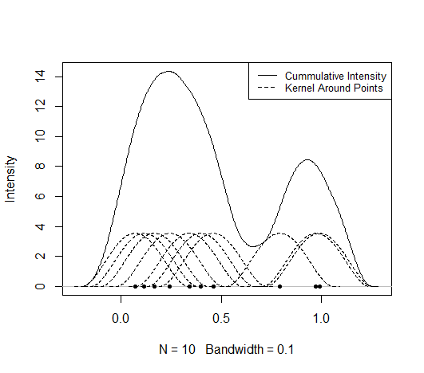
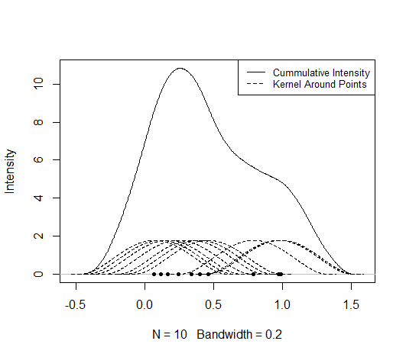
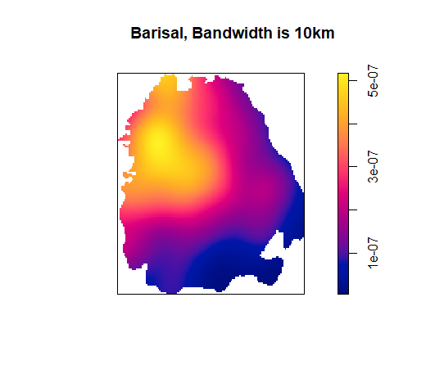
Review: Bandwidth Selection
Large bandwidth would cause over-smoothing
Small bandwidth would cause granularity
Bandwidth choice for the study areas by visual inspection: 5 kilometers for both Barisal and Sylhet

Slide 7
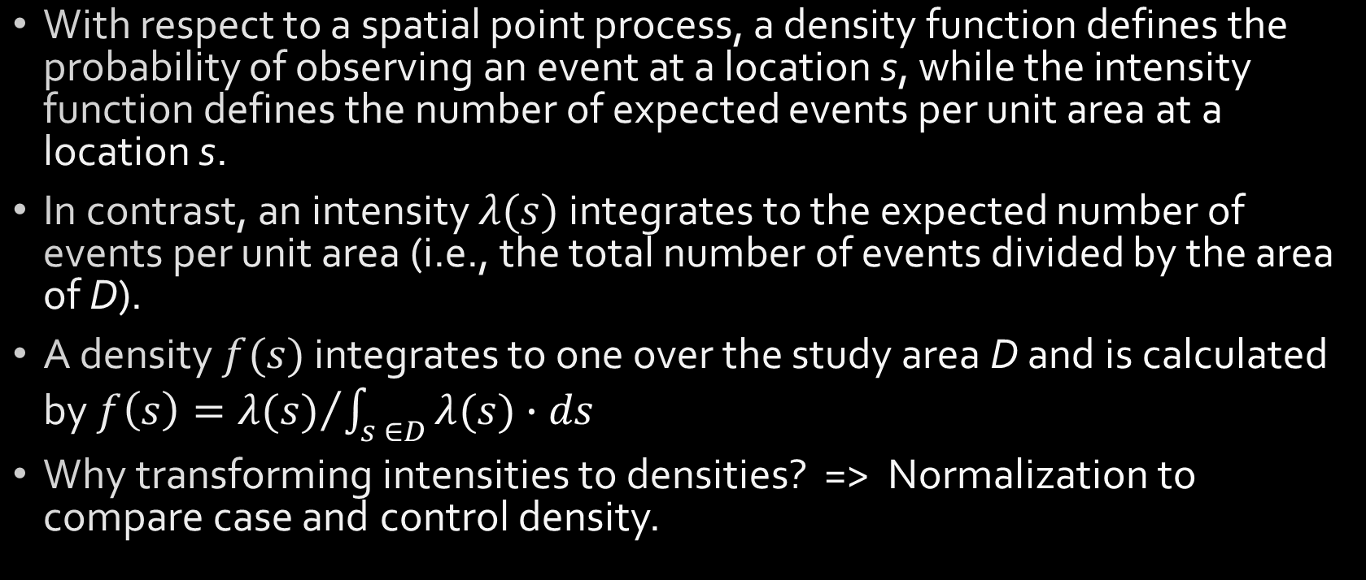
Review: Kernel Intensity/Density
With respect to a spatial point process, a density function defines the probability of observing an event at a location s, while the intensity function defines the number of expected events per unit area at a location s.
In contrast, an intensity $λ(s)$ integrates to the expected number of events per unit area (i.e., the total number of events divided by the area of D).
A density $f(s)$ integrates to one over the study area D and is calculated by $f\left(s\right)={λ(s)}/{\int_{s ∈D}{λ(s)∙ds}}$
Why transforming intensities to densities? => Normalization to compare case and control density.

Slide 8
Review: Thinning
To spatially vary the density of the case and control patterns with respect to an underlying probability surface, an initially completely spatial random (CSR) patterns needs to be thinned by the rejection algorithm (Waller, 2004)
Thinning means either keeping or deleting randomly a point with a given probability from the CSR point pattern.
The probability is determined by the underlying probability surface at a particular location
All points are evaluated independently from each other by rejection sampling.
Random thinning generates an inhomogenous point pattern that mirror the underlying probability surface.

Slide 9
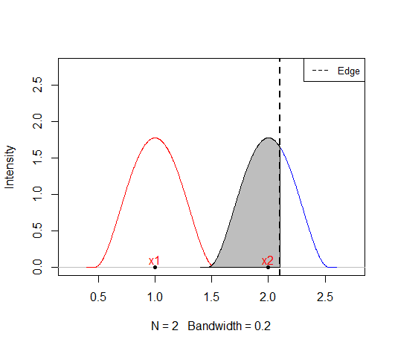
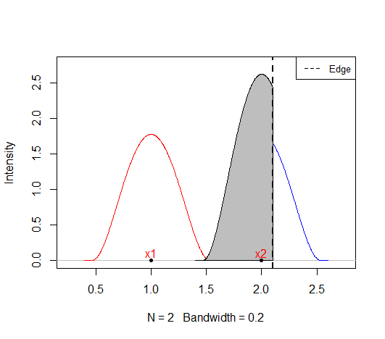
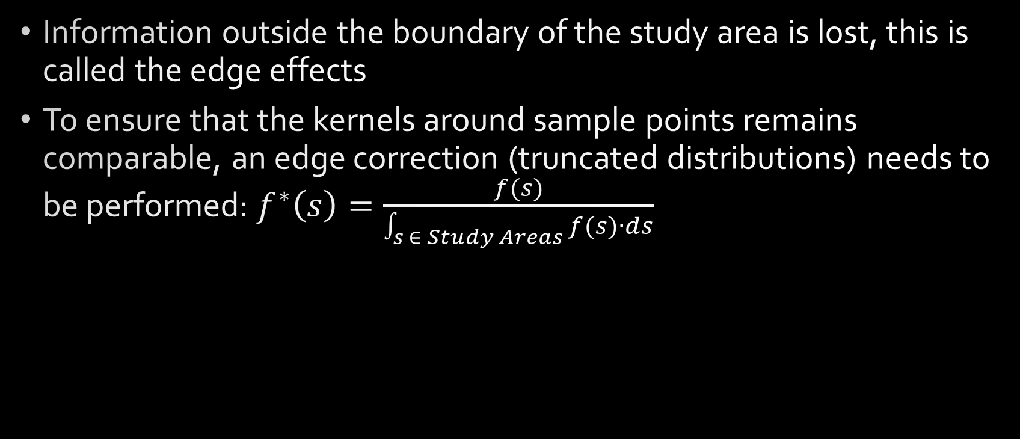
Review: Edge Correction:
Information outside the boundary of the study area is lost, this is called the edge effects
To ensure that the kernels around sample points remains comparable, an edge correction (truncated distributions) needs to be performed: $f^{∗}\left(s\right)=\frac{f(s)}{\int_{s ∈ Study Areas}{f(s)∙ds}}$

Slide 10
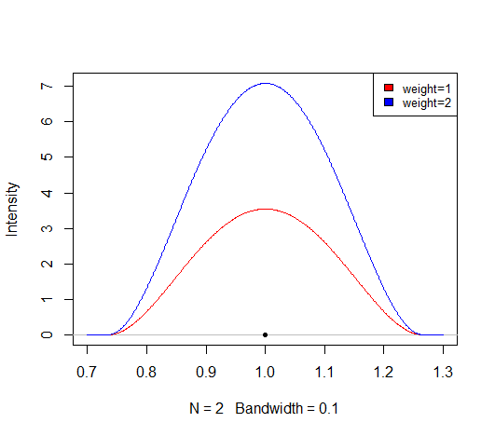
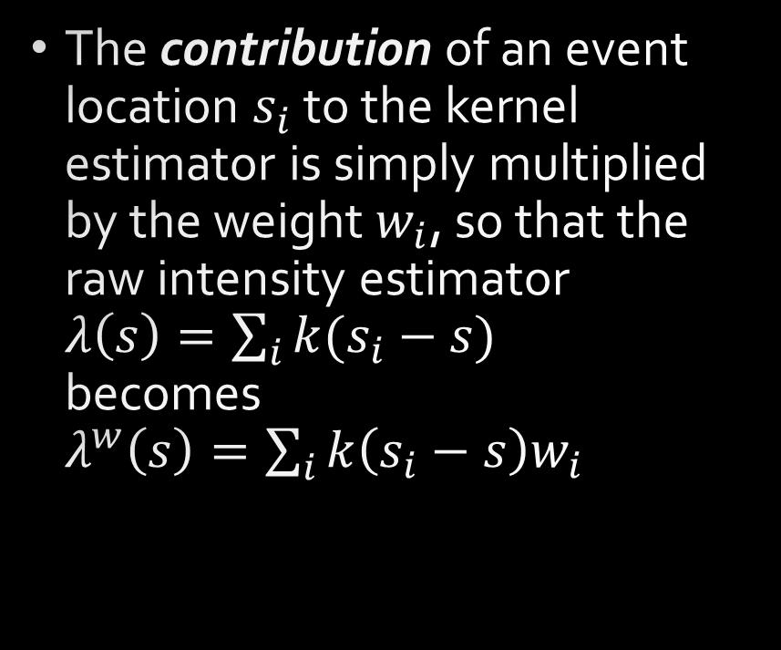
Review: Impact of Weights
The contribution of an event location $s_{i}$ to the kernel estimator is simply multiplied by the weight $w_{i}$, so that the raw intensity estimator $λ\left(s\right)=\sum_{i}{k(s_{i}−s) }$ becomes $λ^{w}\left(s\right)=\sum_{i}{k\left(s_{i}−s\right)w_{i}}$

Slide 11
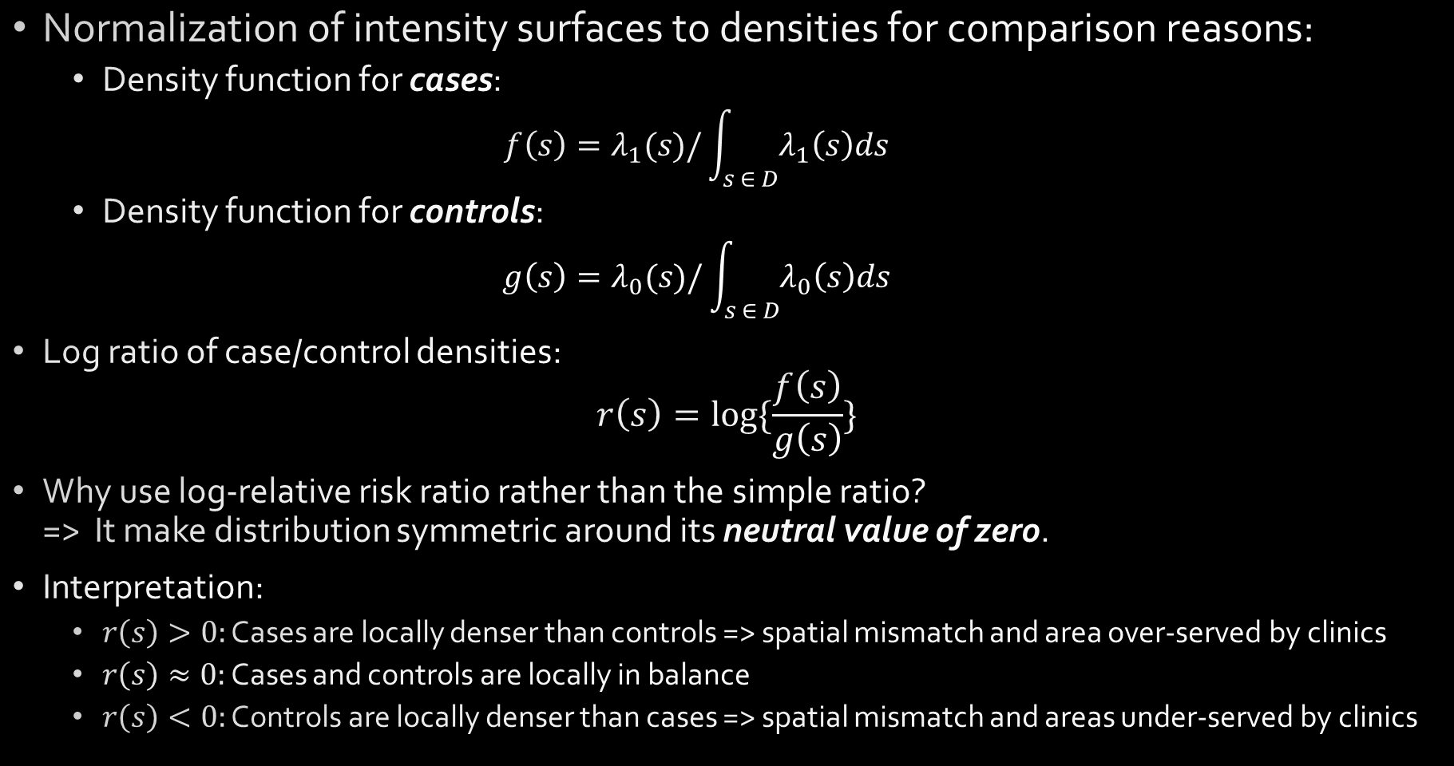
Review: Log Relative Risk Ratio
Normalization of intensity surfaces to densities for comparison reasons:
Density function for cases:
$$f\left(s\right)=λ_{1}(s)/\int_{s ∈ D}{λ_{1}\left(s\right)ds}$$
Density function for controls:
$$g\left(s\right)=λ_{0}(s)/\int_{s ∈ D}{λ_{0}\left(s\right)ds}$$
Log ratio of case/control densities:
$$r\left(s\right)=log⁡\{\frac{f\left(s\right)}{g\left(s\right)}\}$$
Why use log-relative risk ratio rather than the simple ratio? => It make distribution symmetric around its neutral value of zero.
Interpretation:
$r\left(s\right)>0:$ Cases are locally denser than controls => spatial mismatch and area over-served by clinics
$r\left(s\right)≈0:$ Cases and controls are locally in balance
$r\left(s\right)<0:$ Controls are locally denser than cases => spatial mismatch and areas under-served by clinics
Notes:
Show f/g

Slide 12
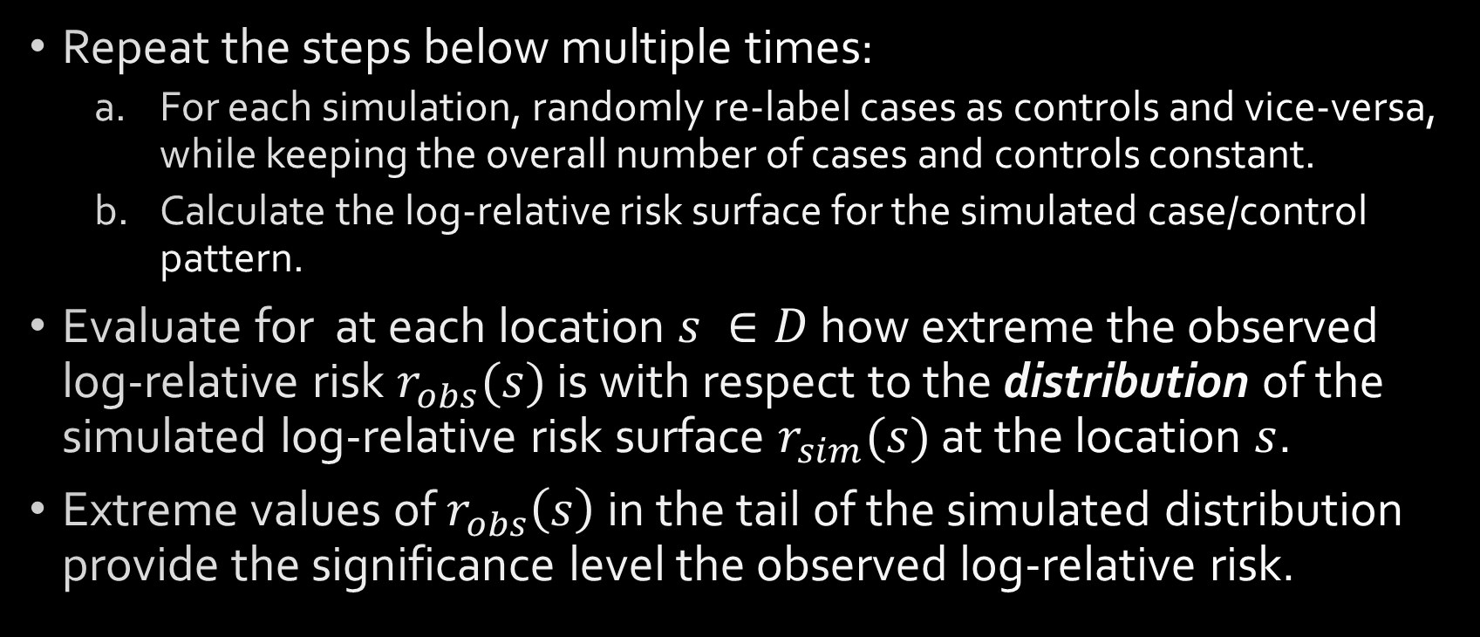
Review: Evaluating the log-relative Risk Significance Levels using Simulation
Repeat the steps below multiple times:
For each simulation, randomly re-label cases as controls and vice-versa, while keeping the overall number of cases and controls constant.
Calculate the log-relative risk surface for the simulated case/control pattern.
Evaluate for at each location $s ∈D$ how extreme the observed log-relative risk $r_{obs}(s)$ is with respect to the distribution of the simulated log-relative risk surface $r_{sim}(s)$ at the location $s$.
Extreme values of $r_{obs}\left(s\right)$ in the tail of the simulated distribution provide the significance level the observed log-relative risk.

Slide 13
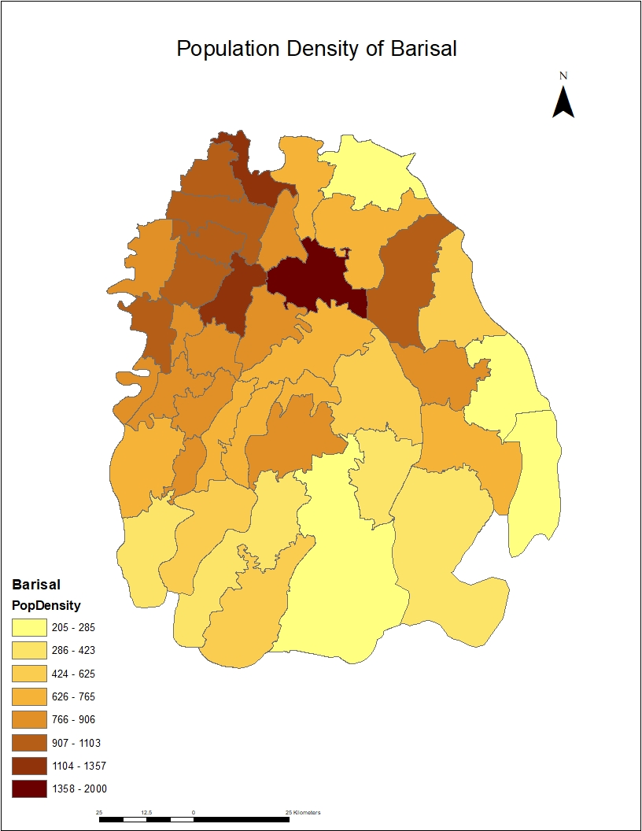
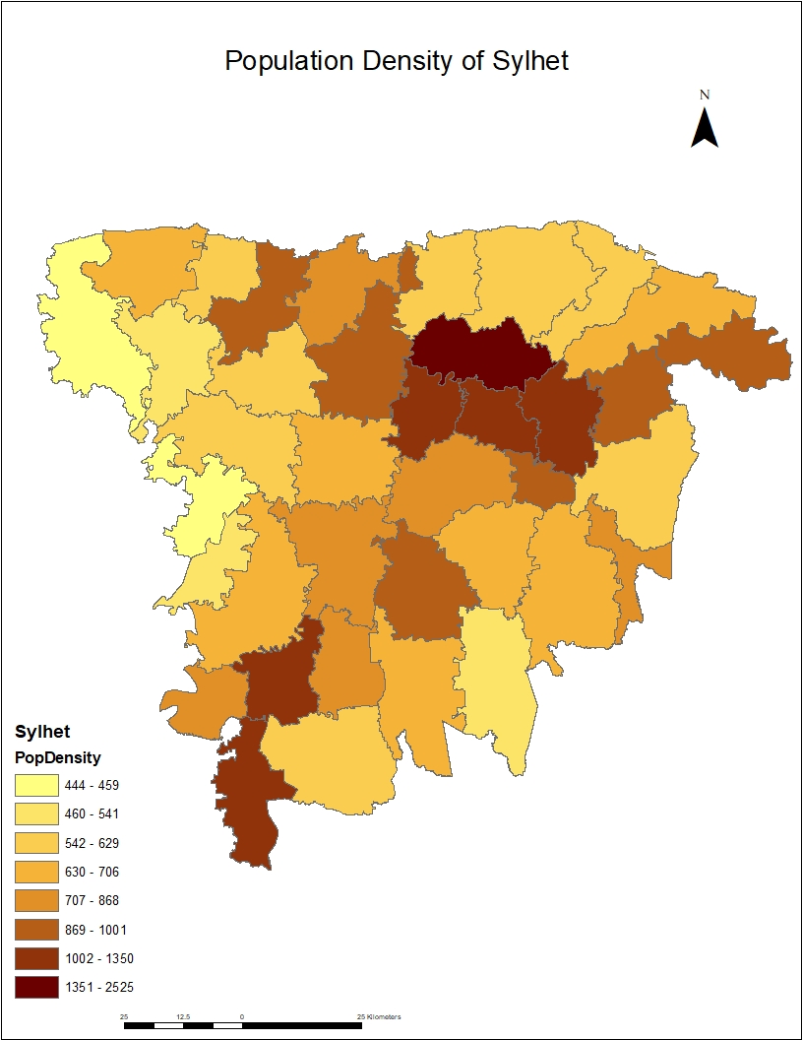
Example: Approximation of Weight Surface
Population density is available at a coarser sub-districts level.
However, sub-districts are still internally too heterogeneous to be model the demand densities for the hospital locations.

Slide 14
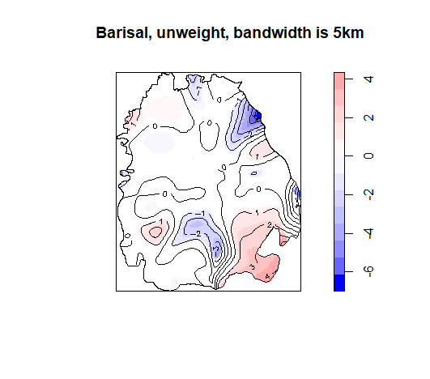
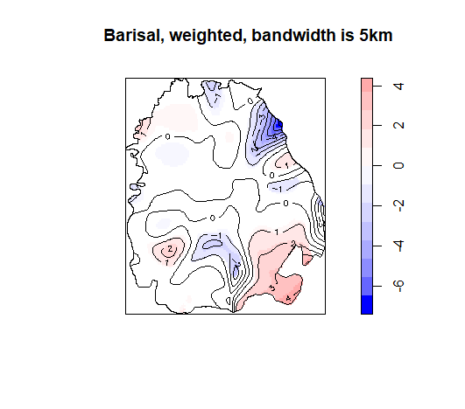
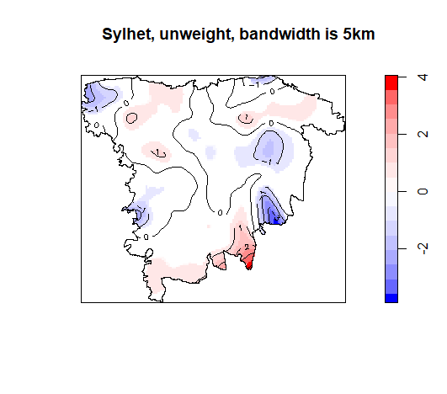

Example: The Log-Relative Risk Surfaces
A two-sided significance level of 5% was selected. ⇒ All color coded areas are significant.
Map Organization:
Left: unweighted log-relative risk surfaces
Right: case and control densities jointly weighted by sub-district population
Findings:
Significant areas of over- (red) and under-supply (blue) of hospitals relative to the spatial distribution of the schools
Jointly weighting both surfaces has no impact on the log-relative risk surface.

Slide 15
Experiment: Objective, Study Design and Expected Results
Objective:
Investigate the impact of weights on relative risk surfaces in structured simulation experiments:
Use of common underlying weight surfaces for case and controls locations
Use different weights surfaces of cases and controls points
Study Design:
Use an simple triangular study area:
a corner dominated by cases,
a corner neutral,
a corner dominated by controls.
Vary the number of cases relative to the number of controls
Systematically vary the weights surfaces
Expected results:
A weights surface common to both cases and controls has no impact
Different weights surfaces for case and controls change the log-relative risk when compared to the unweighted log-relalative risk.

Slide 16
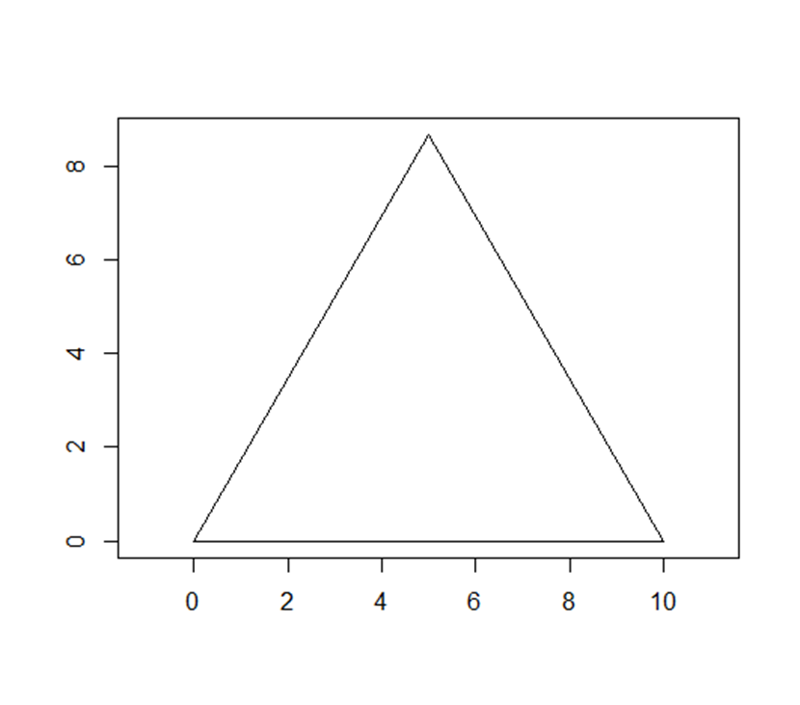
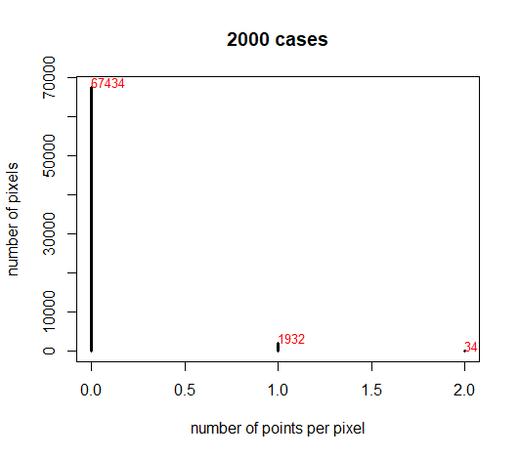
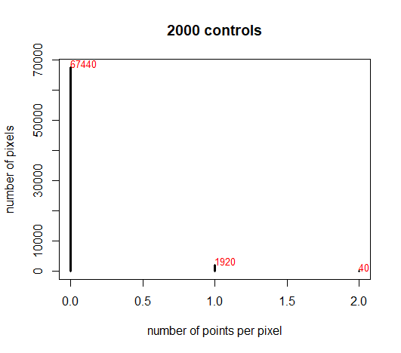
Experiment: Generation of Point Patterns
The underlying assumption for random spatial point patterns is that they satisfies the Poisson assumptions
One Poisson assumption: no more than 1 point per pixel
A balance has to be found between the pixel size and the number of points to control the computation burden
Selected solutions: 2000 points, width of pixels is 0.025
Outline of study area
Distribution of cases
Distribution of controls
Notes:
May be dropped

Slide 17
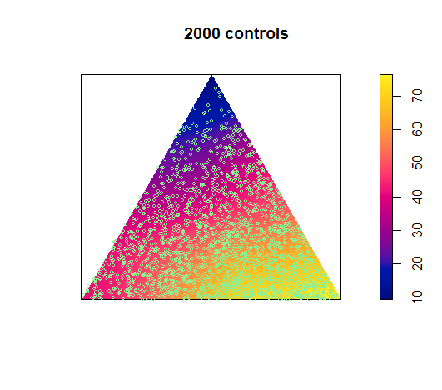
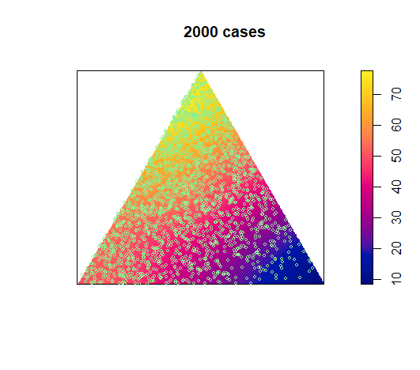
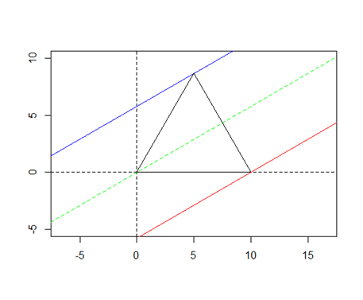
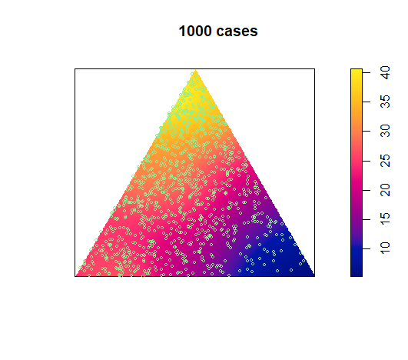
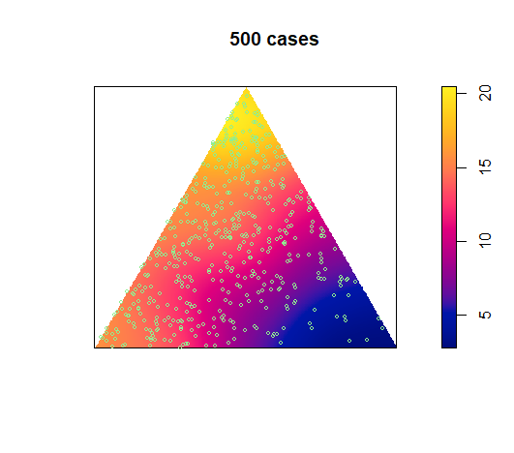
Experiment: Thinning of Cases
Generation of point patterns
Notes:
Captions

Slide 18
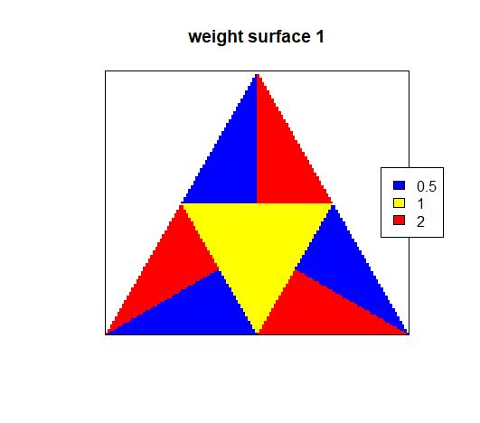
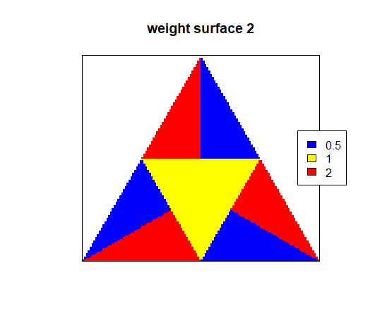
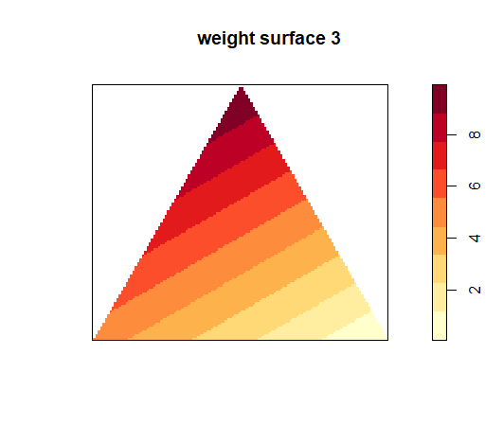
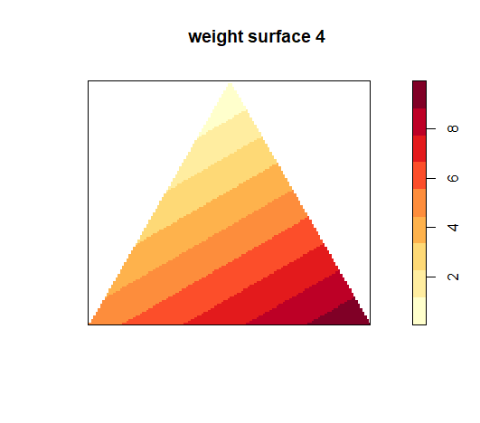
Experiment: Design of Weights Surfaces
4 systematic weights surfaces:
Surface 1 and 2: break case and control areas up opposite directions into high and low weights.
Surface 3: follows the density of the cases.
Surface 4: follows the density of the controls.

Slide 19
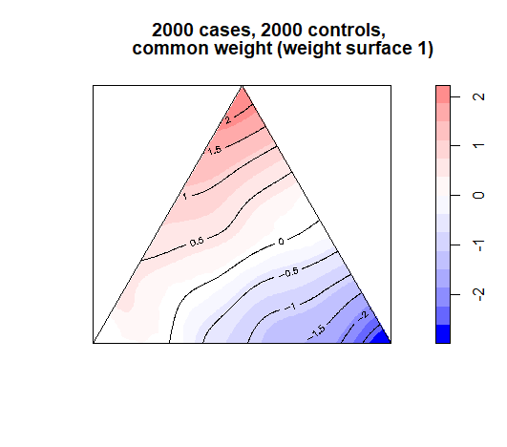
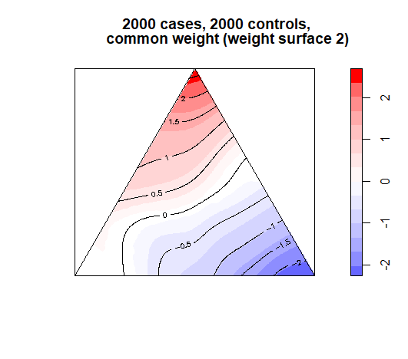
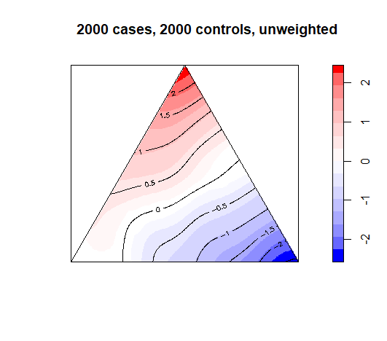
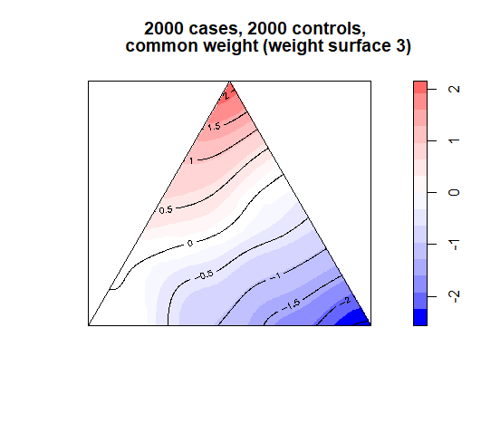
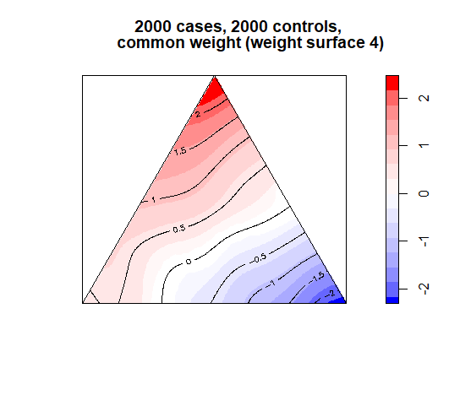
Experiment: Results of Common Weight Surface for Cases and Controls
Identical finding as in the motivational example: ⇒ for identical numbers of case and control points no impact is observed on the log-relative risk surfaces.

Slide 20
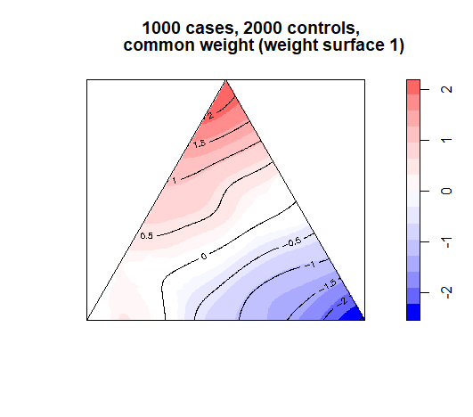
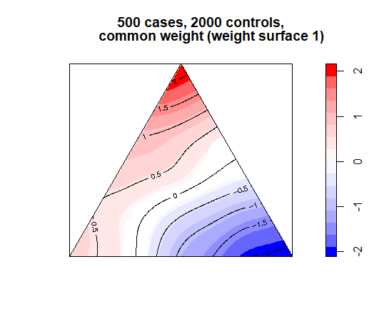
Experiment: Impact of Decreasing number of cases under a common Weight Surface
Thinning the number of cases has up to random variations in the simulations of the significance pattern on impact

Slide 21

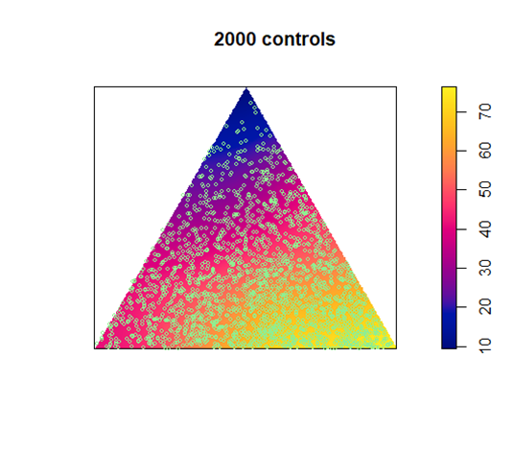


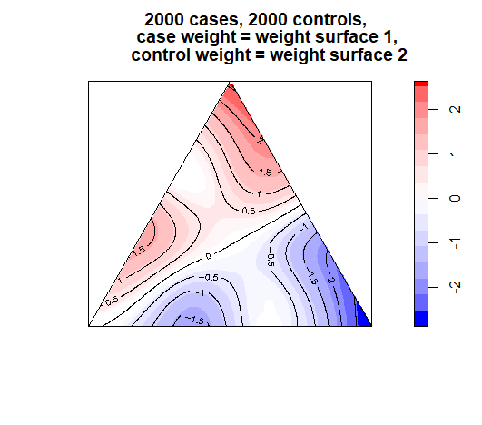
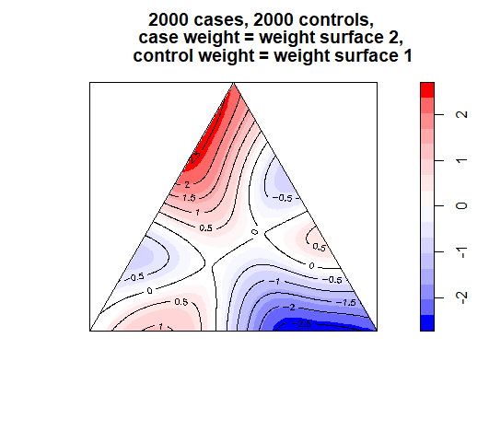

Experiment: Results of Differential Weight Surfaces for Cases and Controls (I)
Input Surfaces:
For same number of cases and controls:
The alternating pattern of surface 1 and 2 splits the case and control areas in the middle
Notes:
Split into two slides: one for alternating weights surfaces. One for accelerating and counterbalancing weights surface

Slide 22




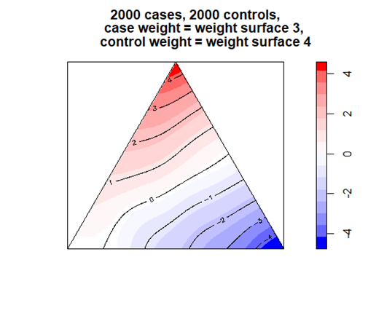
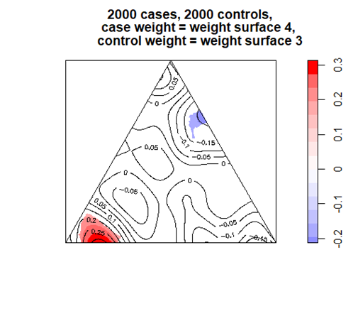

Experiment: Results of Differential Weight Surfaces for Cases and Controls (II)
For same number of cases and controls:
Weight surfaces matching the case and control intensities intensify the log-relative risk pattern
Weight surfaces opposing the case and control intensities diminish the log-relative risk pattern.
Input Surfaces:

Slide 23
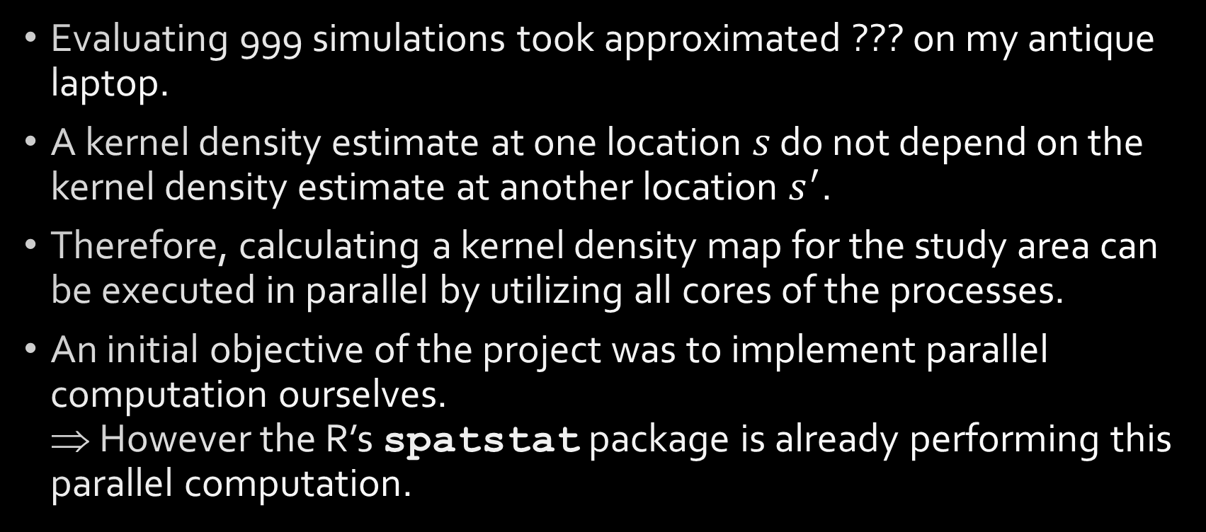
Using Parallel Computation
Evaluating 999 simulations took approximated ??? on my antique laptop.
A kernel density estimate at one location $s$ do not depend on the kernel density estimate at another location $s^{′}$.
Therefore, calculating a kernel density map for the study area can be executed in parallel by utilizing all cores of the processes.
An initial objective of the project was to implement parallel computation ourselves. ⇒ However the R’s spatstat package is already performing this parallel computation.
Notes:
May be dropped

Slide 24
Conclusions and Contributions
Implemented a systematic study design to show the influence of common and differential weights on log-relative risk case-control surfaces.
Impact of weights on log-relative risk case-control surfaces:
As long as the weight surface is common to both cases and controls, the log-relative risk surface is identical to the unweighted surface ⇒ common weights can be ignored.
In contrast, for case and control specific weight surfaces, no generalization can be made. The case and control weight surfaces need to be considered explicitly.
Demonstrated conceptionally: [a] edge correction (truncated distribution), [a] impact of the band-width, [c] difference between kernel intensity and density, [d] generation of an inhomogeous point process by thinning (rejection sampling), and [e] visualization of the log-relative risk surfaces with a divergent map theme.
Adjusted the smacpod::logrr function, which implemented the weights-option incorrectly, and notified the author Dr. French to update the function in the next release.
Notes:
Enhance conclusions

Slide 25
References
Administrative geography of Bangladesh. (2017, November 30). In Wikipedia, The Free Encyclopedia. Retrieved 22:22, December 3, 2017, from https://en.wikipedia.org/w/index.php?title=Administrative_geography_of_Bangladesh&oldid=812813583
Bangladesh. (2017, November 26). In Wikipedia, The Free Encyclopedia. Retrieved 01:34, November 30, 2017, from https://en.wikipedia.org/w/index.php?title=Bangladesh&oldid=812136191
Baddeley, A., Rubak, E., & Turner, R. (2015). Spatial point patterns: methodology and applications with R. CRC Press.
Waller, L. A., & Gotway, C. A. (2004). Applied spatial statistics for public health data (Vol. 368). John Wiley & Sons.
Han, D., Nie, J., Freudenheim, J. L., Vena, J. E., Bonner, M. R., Trevisan, M., ... & Rogerson, P. A. (2005). Assessing spatio-temporal variability of risk surfaces using residential history data in a case control study of breast cancer. International Journal of Health Geographics, 4(1), 9.
Hand, D. J. (2010). Statistical Detection and Surveillance of Geographic Clusters. Journal of the Royal Statistical Society: Series A (Statistics in Society), 173(4), 937-938.
Kelsall, J. E., & Diggle, P. J. (1995). Kernel estimation of relative risk. Bernoulli, 3-16.
Kelsall, J. E., & Diggle, P. J. (1995). Non‐parametric estimation of spatial variation in relative risk. Statistics in medicine, 14(21‐22), 2335-2342.
Notes:
Add more references

Slide 26
More References
Priyankas’ thesis
Smacpod
Spatstat
Notes:
Fill in

